Slide 1

Big Mountain Ski Report
Ticket Pricing Model

Slide 2
Goal of this project
Provide insight for pricing and investment direction.
Develop a ticket pricing model for ski resort tickets in their market sector.
Build a predictive model for ticket prices.
Provide insight into what facilities are most significant to visitors.

Slide 3
Key Findings
Permanently closing up to 10 of the least used runs.
Can close up to 5 runs resulting in ticket prices and revenue drop
Increase vertical drop by 150ft and addition of a chair lift
Validates ticket price increase of $8.36 and additional revenue of $14.6 million
Number 2 plus the addition of 2 acres of snow making
Validates ticket price increase of $9.23 and additional revenue of $16.1 million
Extending the longest run by 0.2 miles (boasting the longest run) and additional snow making of 4 acres
Resulted in no change in ticket price
Recommendation Permanently closing up to 10 of the least used runs.
Can close up to 5 runs resulting in ticket prices and revenue drop

Slide 4
Modeling Data
Big Mountain Resort modelled price is $96.84, actual price is $81.00
MAE(Mean Absolute Error) = $10.35
Price Assumption
This suggests there is room for an increase in price
Other resorts accurately set their prices according to what the market (the ticket-buying public) supports.
Big Mountain appears to be undercharging with the actual price being much lower than the predicted price.
Is the model missing or lacking data?
Are other resorts can be “overpriced” and “underpriced”?
Missing Key data
Missing operating cost to help improve model

Slide 5
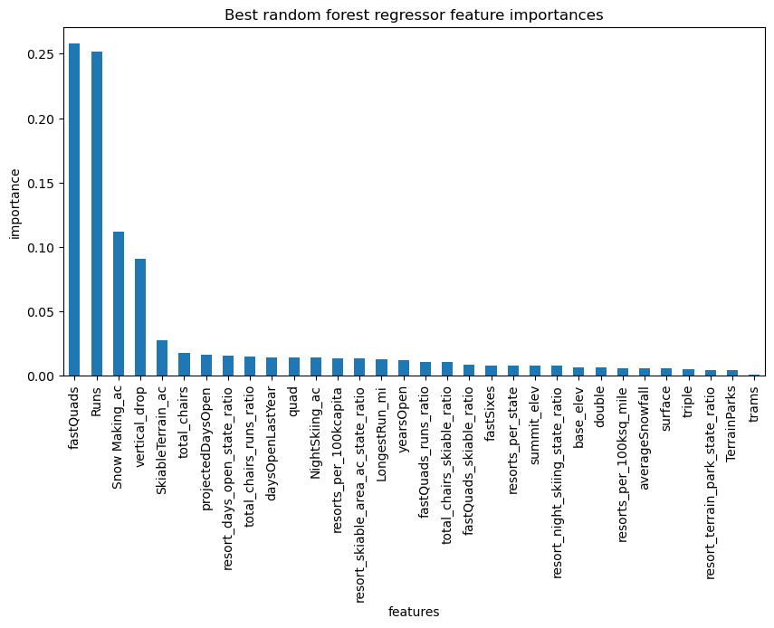
Modeling Results
This linear model shows each feature and its importance level. This could help determine which features to close or which feature contributes more towards revenue.

Slide 6
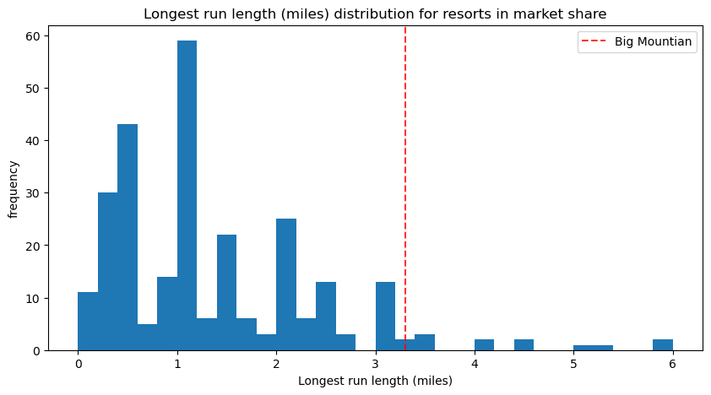
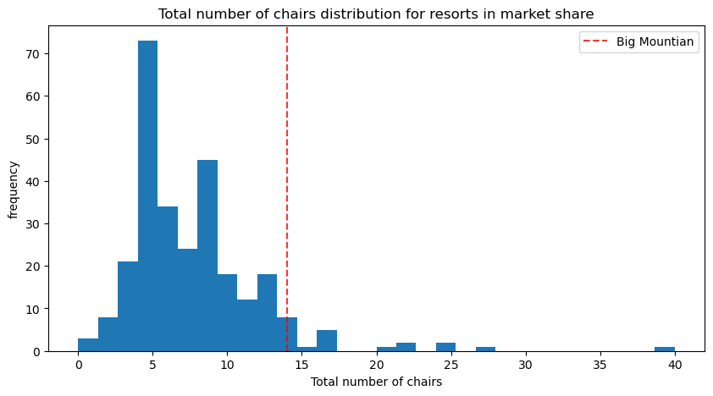
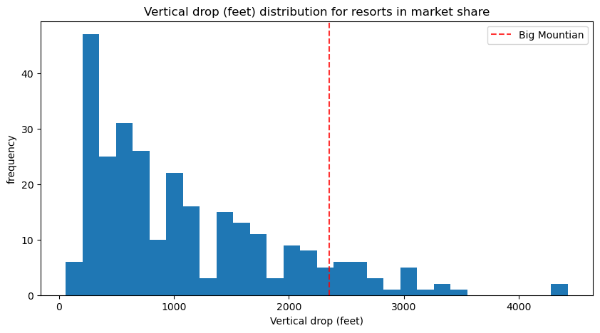
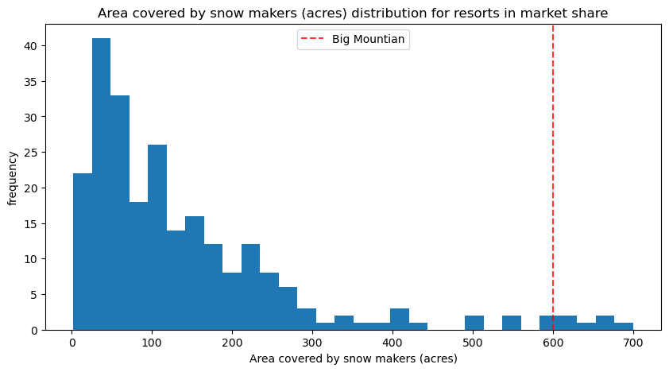
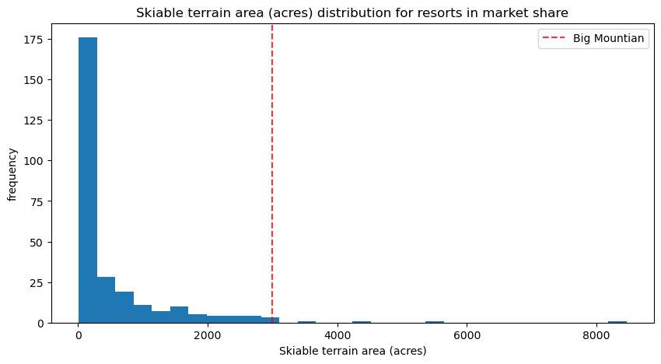
Modeling Features Comparison
Big Mountain has amongst the highest numbers across all important features, notwithstanding some outliers..

Slide 7
Summary
Big Mountain Currently ranks among the top resorts in
Skiable terrain
Number of Runs
Snow making capacity
Number of Chairs
Proposed Scenerios
Closure of 5 least used runs
Increase vertical drop with and without snowmaking
Increase longest run with snowmaking
By closing 5 of the least used runs, it seems like you will be able to generate less revenue since you will be charged less. However, unlike in the other scenarios you will not be incurring costs for installing new lifts, new snowmaking equipment, and grooming the new terrain, which would certainly increase operating costs and lower revenue.

